Slide 1
Azure Networking
Section 3

Slide 2
In this Section, we are going to take a look at…
Networking overview
Virtual networks, subnets, gateways, and peering
Controlling and balancing user traffic
Managing NIC cards and addressing
Securing network traffic
Domain services
Monitoring network resources
Scripting network resources

Slide 3
Networking Overview

Slide 4
In this Video, we are going to take a look at…
Networking concepts and design
Network resource overview

Slide 5
Networking Concepts
Connectivity between Azure resources
Internet connectivity
On-premises connectivity
Load balancing and traffic direction
Network security
Network routing
Network manageability and monitoring

Slide 6
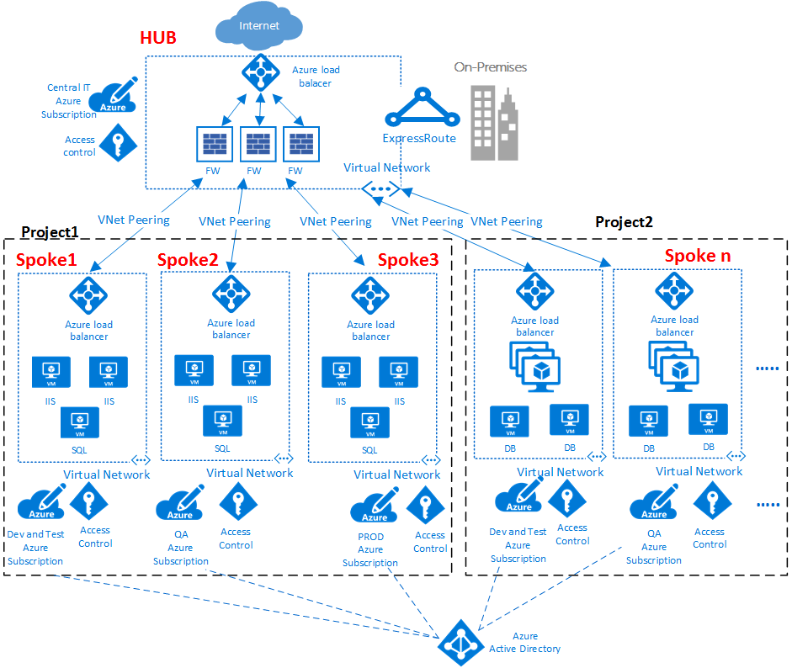

Slide 7
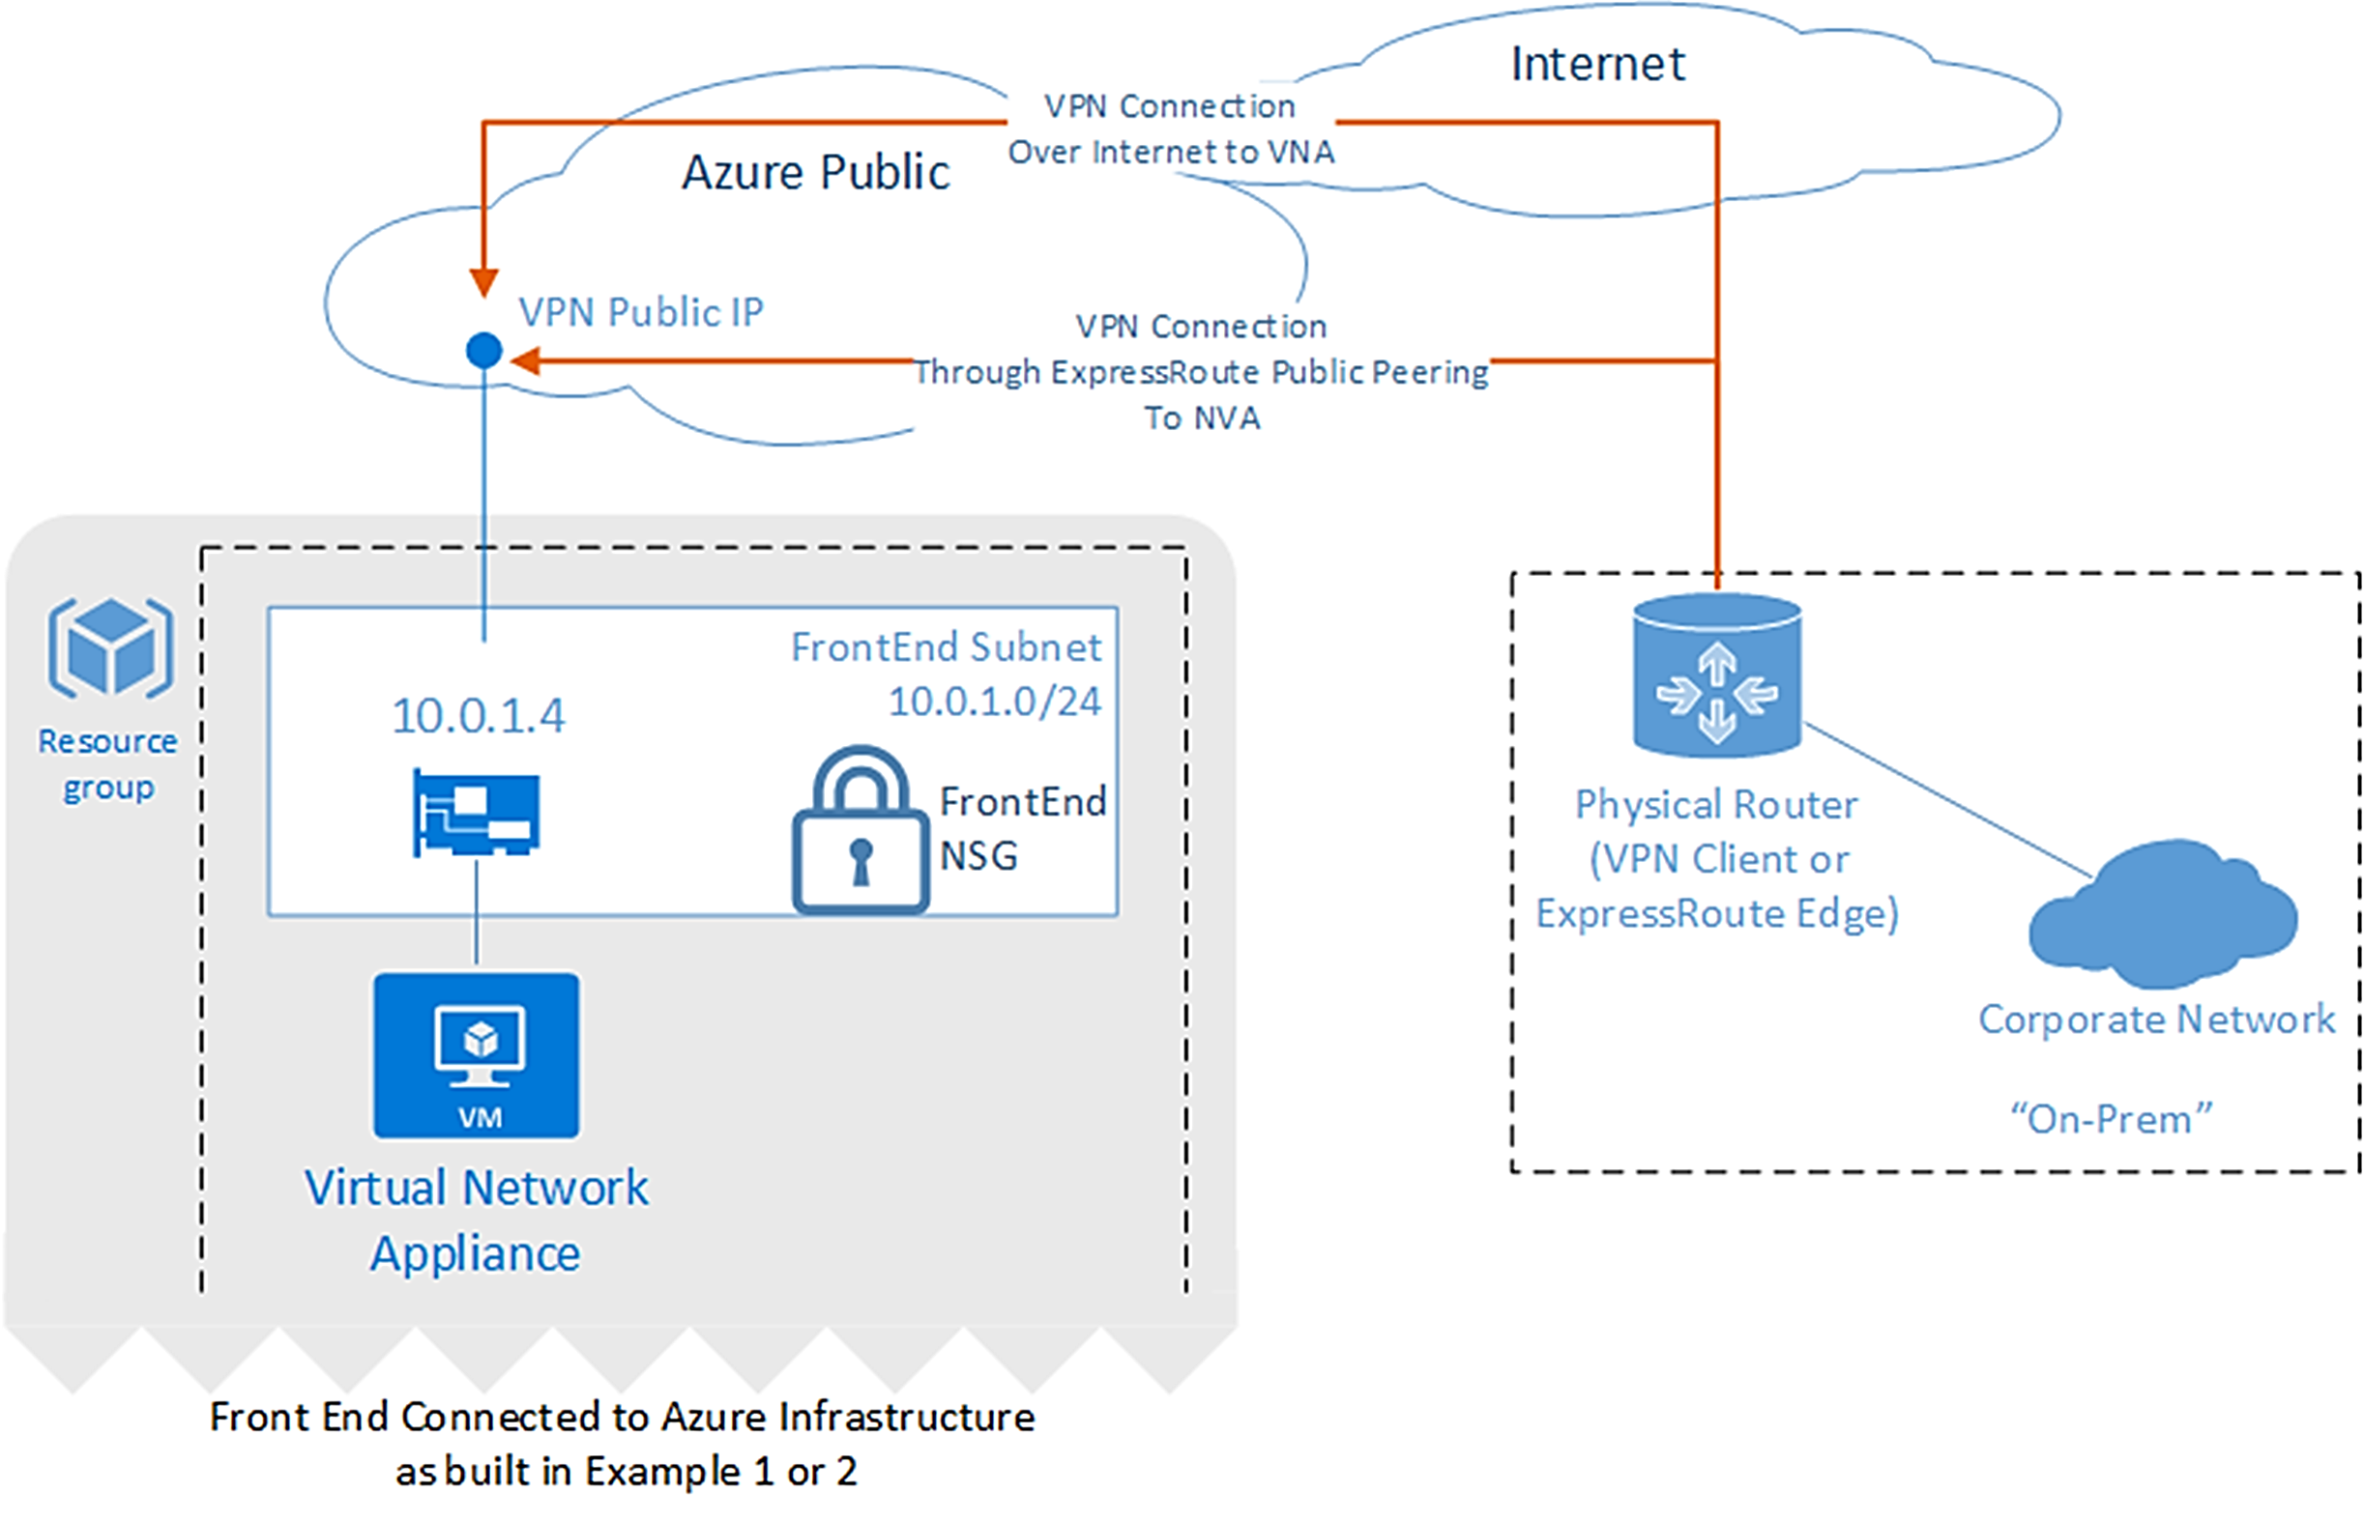

Slide 8
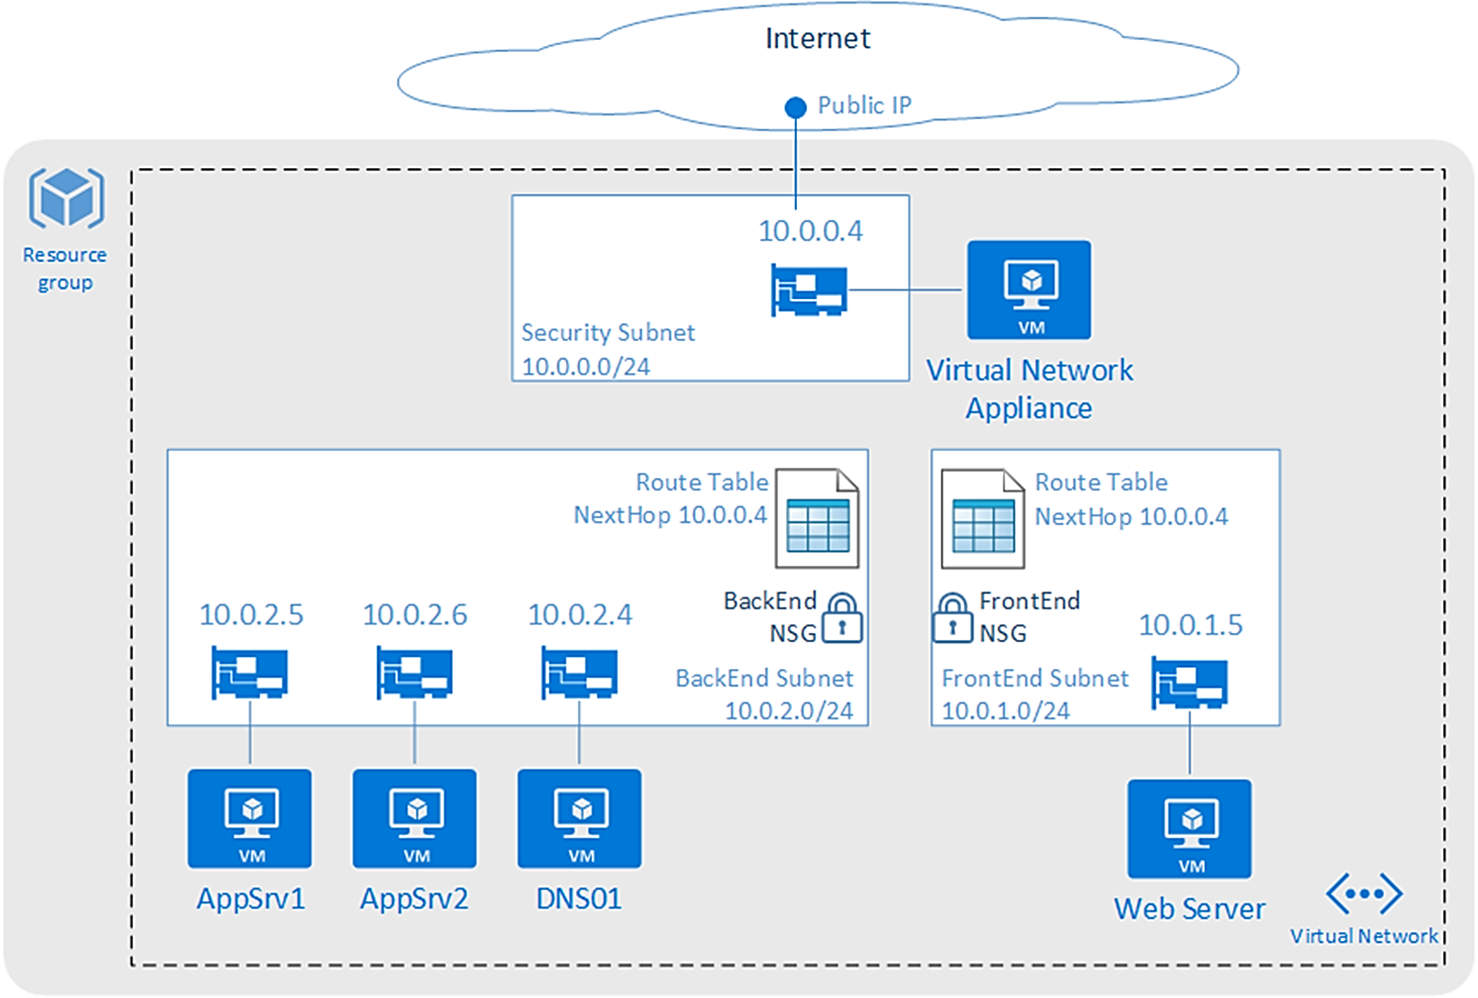

Slide 9
Networking, Subnets, Gateways, and Peering – Part One
Next Video

